Slide 1

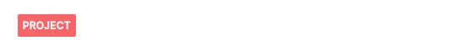


José Miguel González

Slide 2

Very short introduction to ALM
Invest company’s money in function of expected liabilities with the aim of:
  Reduce repayment risk.
  Avoid reinvestment risk .
  Mitigate interest rate movements.
Applied by financial institutions: Banks and Insurance companies.

Slide 3
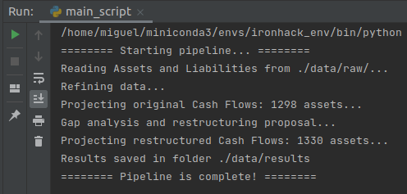
What do this pipeline does?
OUTPUTS
INPUTS
Assets to Sell
Assets
Assets to Buy
CF Liabilities
Current Status
RESTRUCTURING PROPOSAL

Slide 4
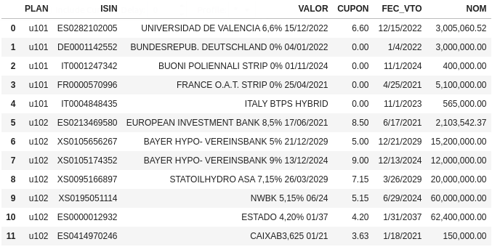
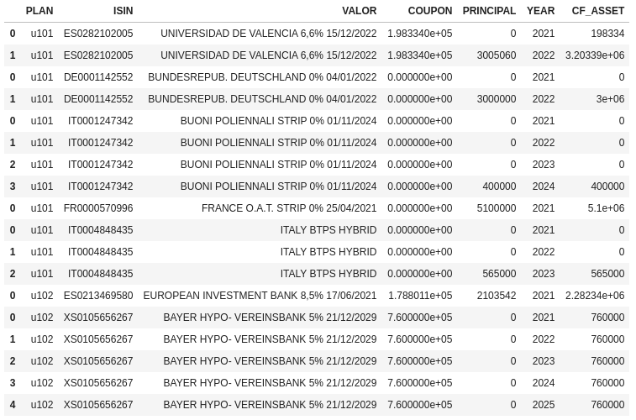
Cash Flow Asset Projection
Projection by portfolio, year and asset of:
- Coupon payments
- Principal devolution

Slide 5
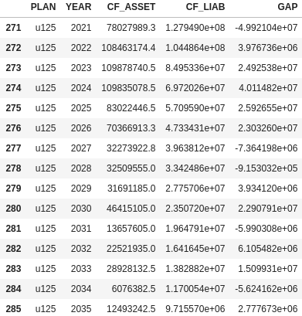
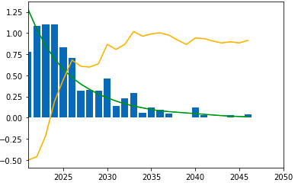
Assets and Liabilities combination
ALM portfolio “u125”:

Slide 6
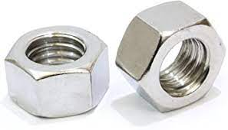
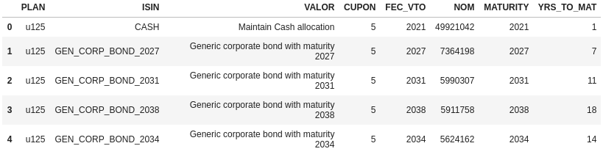
Sells and Purchases to restructure
List of asset to remove and switch by a generic set of assets:

Slide 7
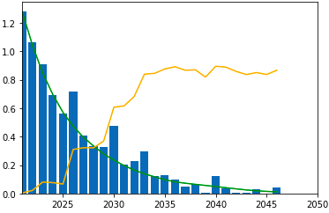
Restructuring results:
Original ALM portfolio “u125”:
Restructured ALM portfolio “u125”:

